Slide 1
Meeting virtual and Face to Face
Team Benzene
27/11/2024

Slide 2
Content Slide – Title
Meeting Etiquette
Face to Face Meeting
Meeting Virtual

Slide 3
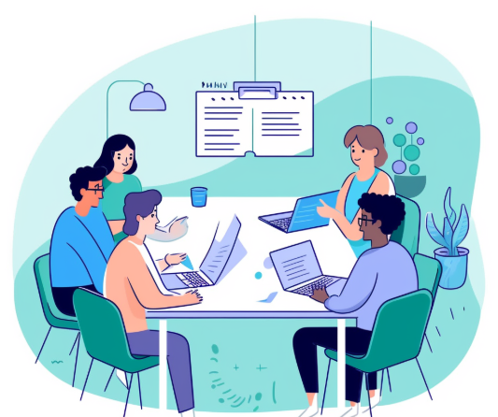
Meeting Etiquette-Face to Face
What is meeting Etiquette?
The standard of behavior expected in the workplace during meetings.
Meeting etiquette is important to respect others time and project a professional image.
Good meeting etiquette shows dependability and that the subject matter is valued by all attendees.

Slide 4


Rules for face-to-face meeting etiquette
Rule 1
Confirm or acknowledge your participation to join when you have been sent an invitation to attend the meeting.
Rule 2: Be punctual
That's right, show up on time. Rather, show up early enough to get settled at the location.
If you are late, proceed quietly and with the least amount of interruption of taking your seat.
The objective is to NOT BE LATE!
Do not expect others to fill you in during or after the meeting.

Slide 5


Rules for face-to-face meeting etiquette
Rule 3: Meeting Leader
Keep your work status/presentation equipment ready to go by start of meeting.
Rule 4: Don't interrupt
Don't interrupt the presenter while he is speaking. Only speak once other has completed his part.
Don't interrupt other attendees. Wait your turn for the full conclusion of that individual's input and the response from the speaker

Slide 6


Rules for face-to-face meeting etiquette
Rule 5: Mute electronics
Turn on vibrate or turn off completely.
If you forgot to turn off your phone, don't answer your phone while in the meeting.
Do not text.
Do not check emails.
Rule 6: Questions
Do not blurt your question out in the middle of the presentation.
Keep your questions simple, direct, and brief.
Ask one question at a time and wait for the answer.

Slide 7


Rules for face-to-face meeting etiquette
Rule 8: Remain composed
Do not tap your pen, flip through material, tap your foot, fuss, fidget, or conduct yourself in a way that is distracting to others.
Rule 7: Actively listen
Pay attention to the information the speaker is addressing, and
The questions of the other participants so that your question does not repeat what was already covered.

Slide 8


Rules for face-to-face meeting etiquette
Rule 10: Create an agenda
Distribute agenda to participants prior to the meeting.
Stay on topic to the agenda.
Rule 9: Attend the entire meeting
If you must leave early, send notification prior to the meeting and receive confirmation.
Stick with meeting timeline.
Start on time!
If the meeting is scheduled for 30 minutes or an hour, stay true to your meeting timeline.
End on time

Slide 9

Rules for face-to-face meeting etiquette
Rule 11: Conduct yourself professionally
Do not use profanity or slang.
Be polite.
Rule 12: Meeting conclusion
As a participant, thank the speaker, coordinator, meeting leader (this could be just one person).
As the meeting leader, follow-up with participants, circulate list of action items, resolutions, and issues that remain open.
As the participant, complete tasks assigned to you and without delay.
As the meeting leader, thank people for attending.
As the meeting leader, request feedback.
As the participant, provide your feedback

Slide 10
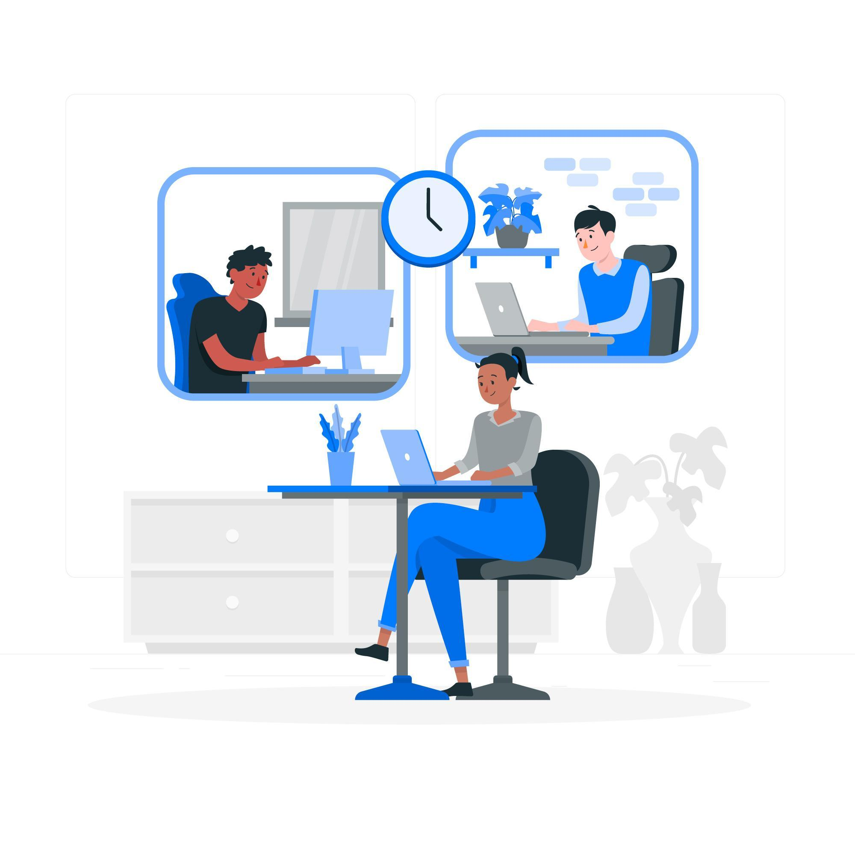
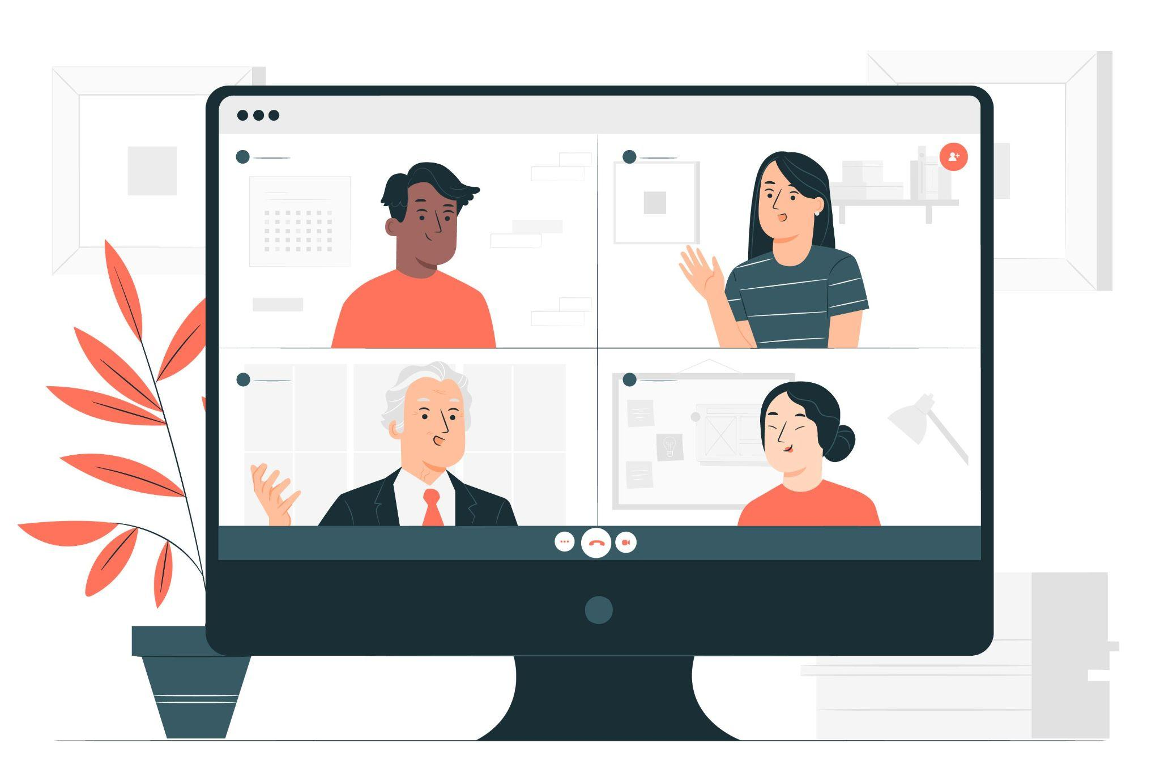
Virtual meeting etiquette
Planning
As a team, or majority of the team, agree
upon a consistent virtual meeting day and time.
Pre meeting
Project manager should decide how to virtually host the meeting.
Determine what the meeting goals and agenda will be and verify with other important team members.

Slide 11


Virtual meeting etiquette
Pre meeting
Project manager should send out a email invite/reminder about the meeting.
Give RSVP deadline.
Send the agenda.
Double check spelling and grammar.
Send invites to correct team members.
Pre meeting
Invited meeting attendees should RSVP in a timely manner.
Inform the project manager or meeting facilitator of extra notes or content for meeting agenda( if needed)
Notify if you will be late.
Notify if you cannot attend.

Slide 12
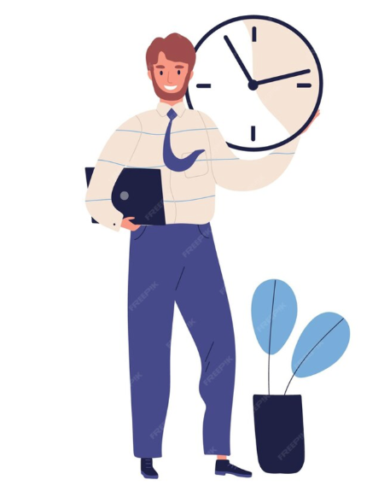
Virtual meeting etiquette
Pre meeting
The manager should be online at
virtual meeting location 5-10 minutes
before start time.
Pre meeting
Meeting attendees should make sure that all equipment is working ahead of time.

Slide 13

Virtual meeting etiquette
Meeting time
Attendees should arrive a few minutes before or exactly at the start time.
Dont
Show up late without telling anyone.
Be unprepared with what the meeting is about.
Manager must make sure everyone's speakers and microphone
work properly.
Do’s
Briefly go over meeting agenda.
Remind attendees about virtual meeting etiquette.
Give an estimated end time for the meeting.

Slide 14

Virtual meeting etiquette
Attendee Do’s
Focus on the meeting, eliminate distractions.
Mute your cell phone
Mute your microphone when you are not speaking.
Use the chat box to write questions or comments .
Be prepared to present your work.
Know how to operate virtual meeting tools.
Attendee Dont’s
Get off topic.
Shout into microphone.
Be unprepared as to what is going on.
Be unprepared to operate virtual meeting tools.

Slide 15
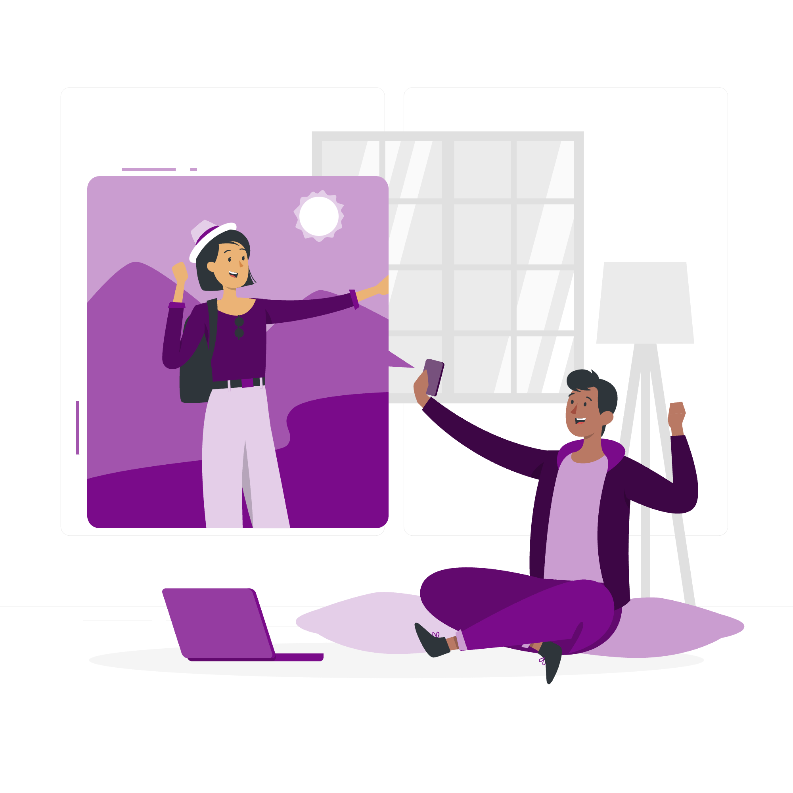
Virtual meeting etiquette
Post Meeting
Project Manager should wrap up the meeting and give a reminder for the next meeting.
Should follow up by sending out the meeting summary to team members no later than a day after the meeting. This will also keep members who were absent on track and in the loop.
Team members do’s
Work that was assigned.
Contact team members or the project manager for help.
Prepare work or progress to report at the next meeting.

Slide 16
Virtual meeting etiquette
Post Meeting
Project Manager Dont’s
Push your work or duties off onto others.
Take too long to follow up and send out meeting notes.
Prepare for next meeting.
Project Manager Do’s
Prepare for the next meeting.
Update files, calendars.
Be available to help and answer questions.

Slide 17
Thank you !

